Slide 1


INFORMATION SECURITY
LECTURE 01
Dr. Muhammad Umar Aftab

Slide 2

Assignment
Install Virtual Box
Install kali Linux in Virtual Box
Download kali linux using following link: https://www.kali.org/

Slide 3
LECTURE CONTENTS
Areas of Information Security
Introduction to Information Security
Security Objectives
Security services ITU-T (X.800)
Reference model for information assurance and security (RMIAS)
Active vs. Passive Attacks
Information Security Terminologies

Slide 4
Areas of Information Security (1/8)
Cyber Defense
Cyber Operations
Digital Forensics
Secure S/W Development
Cyber Policy and Government Law
Cyber Risk Management
Human Behavior

Slide 5
Areas of Information Security (2/8)
Cyber Defense
Cryptography
Data Security
Computer Security
N/W Security
Information Security

Slide 6
Areas of Information Security (3/8)
2. Cyber Operations
Cyber Attacks
Penetration Testing
Cyber Intelligence
Reverse Engineering
Cryptanalysis

Slide 7
Areas of Information Security (4/8)
3. Digital Forensic
H/W and S/W
Incident Response
Cyber Crime
Cyber Law Enforcement

Slide 8
Areas of Information Security (5/8)
4. Secure S/W Development
Secure System Design
Secure Coding
Secure Deployment
Maintainability
Usability of Secure System

Slide 9
Areas of Information Security (6/8)
5. Cyber Policy and Government Law
Laws, Regulation and Acts
Government and Institutional Policies and Practices.

Slide 10
Areas of Information Security (7/8)
6. Cyber Risk Management
Disaster Recovery
Business Continuity
Security Evaluation
Cyber Economics

Slide 11
Areas of Information Security (8/8)
7. Human Behaviors
Social Engineering
Social N/Ws
User Experience
Organizational Behavior

Slide 12
Books
COMPUTER SECURITY PRINCIPLES AND PRACTICE, Fourth Edition, By William Stallings and Lawrie Brown, 2018
Computer and Internet Security, A Hands-On Approach, Wenliang Du, 3rd Edition, Create Space Publications, 2022 (for Labs)

Slide 13
2. Introduction to Information Security

Slide 14
Challenges of Securing Information
Security figures prominently in 21st century world
Personal security
Information security (focused on protecting the electronic information of organizations and users)
Securing information
No simple solution
Many different types of attacks
Defending against attacks often difficult
Information security continues to rank as the number one concern of IT managers
and tens of billions of dollars are spent annually on information security, the number of successful attacks continues to increase.

Slide 15
Today’s Security Attacks
Examples of recent attacks
Fake anti-virus
Taking control of wireless cameras
ATM machine attacks (Malware called Ploutus)
Taking over Twitter accounts
Attackers using online sites such as Craigslist and eBay to lure victims to download malware
Notes:
The Ploutus ATM malware family, first detected in 2013 by Symantec as Backdoor.Ploutus, allows attackers to withdraw cash from an ATM machine on command. The malware is installed by accessing the ATM’s CD-ROM drive and inserting a new boot disk that delivers the Ploutus variant. After connecting an external keyboard to the ATM machine, threat actors must press ‘F8’ to display the hidden trojan window. Once visible, numerous commands can be executed such as pressing ‘F1’ to generate ATM ID, ‘F2’ to activate ATM ID, and ‘F3’ to dispense cash.

Slide 16
What is Information?
Something meaningful
Conveyed by a sequence of symbols.
Symbols can be alphabetics, characters, numbers, punctuations etc.
Physical or logical. So, a book or something on a computer.
Accurate, timely, contextualised , relevant, purposeful, that is specific and can be organized.
Notes:
What Is Information Security?
Before defense is possible, one must understand:
Exactly what security is
How security relates to information security
The terminology that relates to information security

Slide 17
What Is Security?
The state of being free from danger or threats.
Can be applied to both physical and logical scenarios.
Cambridge English Dictionary “Security is the protection of a building, a person, an organization or a country against threats such as crime”.
Security can be provided through
Physical artifacts such as walls and locks.
Logical people and processes, inspections, surveillance, authorizations such as we find in airports.

Slide 18
What Is Information Security?
Combining information and security, we see useful definitions.
Information security is defined as the practice of defending information from un-authorized access, use, disclosure, disruption, modification, inspection, recording or destruction.
A computing-based discipline involving technology, people, information, and processes to enable secured operations of an organization.
It involves the creation, the operations, analysis and testing of secure computer systems.
It is an interdisciplinary course of study, which includes aspects of law, policy, human factors, ethics, and risk management in the context of adversaries.

Slide 19
COMPUTER SECURITY
The NIST Computer Security Handbook defines the term computer security as:
“The protection afforded to an automated information system in order to attain the applicable objectives of preserving the integrity, availability and confidentiality of information system resources.”
(includes hardware, software, firmware, information/data, and telecommunications)

Slide 20
Understanding Security
Security is:
The goal to be free from danger
The process that achieves that freedom
Harm/danger may come from one of two sources:
From a direct action that is intended to inflict (impose) damage
From an indirect and unintentional action
As security is increased, convenience is often decreased
The more secure something is, the less convenient it may become to use

Slide 21
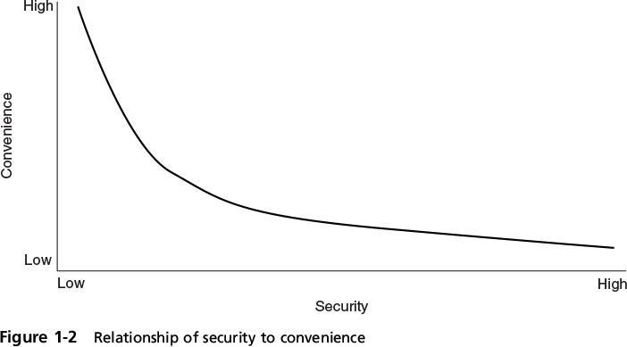
Understanding Security
Security is often described as sacrificing convenience for safety
Notes:
The relationship between security and convenience is inversely proportional.
Consider a house in which the homeowner installs an automated alarm system. The alarm requires a resident to enter a code on a keypad within 30 seconds of entering the house. Although the alarm system makes the house more secure, it is less convenient to race to the keypad than to casually walk into the house.

Slide 22
3. SECURITY OBJECTIVES

Slide 23
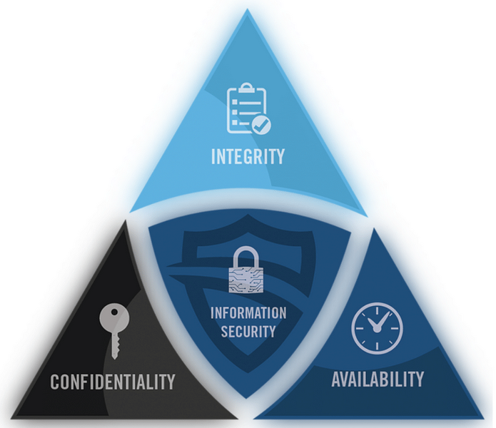
SECURITY OBJECTIVES
Confidentiality
Assures that private or confidential information is not made available or disclosed to unauthorized individuals
Integrity
Assures that information and programs are changed only in a specified and authorized manner
Availability
Assures that systems work promptly and service is not denied to authorized users
Notes:
Information security is intended to protect information that provides value to people and enterprises. Known as the CIA Triad, three protections must be extended over information.

Slide 24
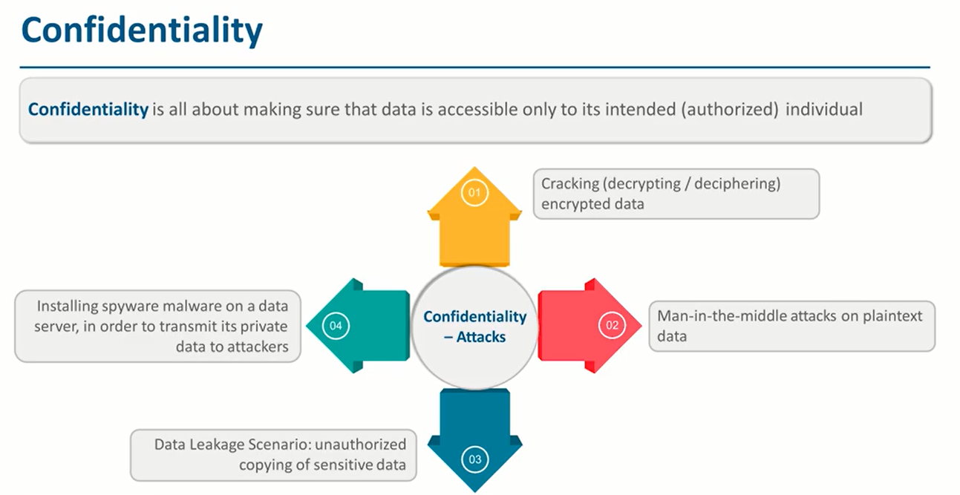

Slide 25
A classic data breach
Employee is sent a phishing email with a link to a realistic looking internal site.
Employee opens the email, clicks the link, and types her user name and password.
Malicious site collects the password and shows the user that everything is actually fine so they are not suspicious.
Malicious actor uses user name and password to download sensitive files.

Slide 26
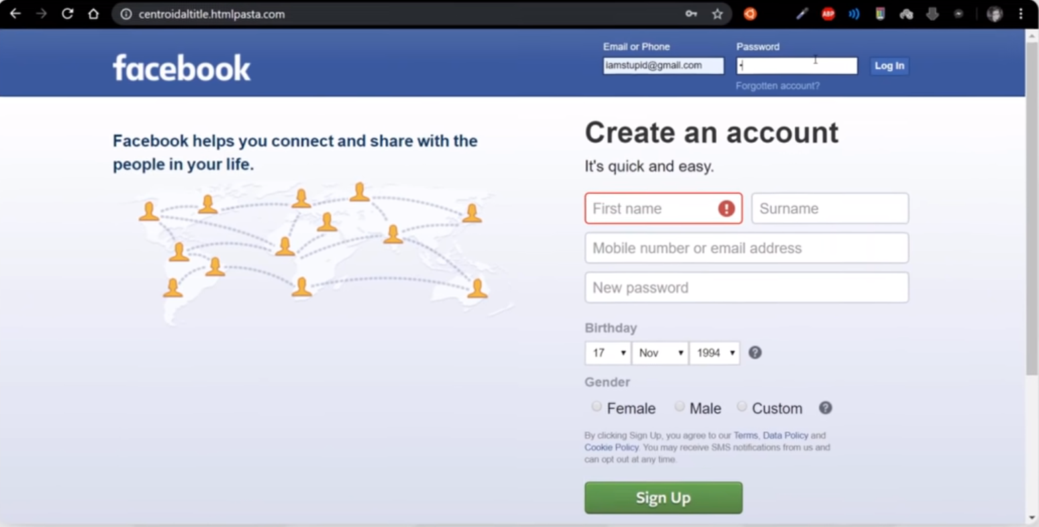
Do you see any problem here

Slide 27
A classic data breach
Prevention:
Detect phishing URLs and mark as spam, train employees to notice phishing, identify offsite access of sensitive files and block, encrypt files so it will become useless if leaked.
Detection:
Identify that sensitive files have been accessed from off site
Response:
Change employee’s password, notify CTO, notify insurer, begin post-breach plan.
Notes:
chief technology officer (CTO)

Slide 28
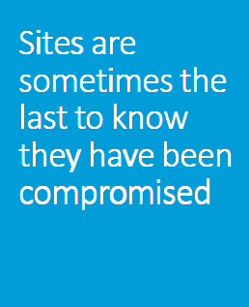
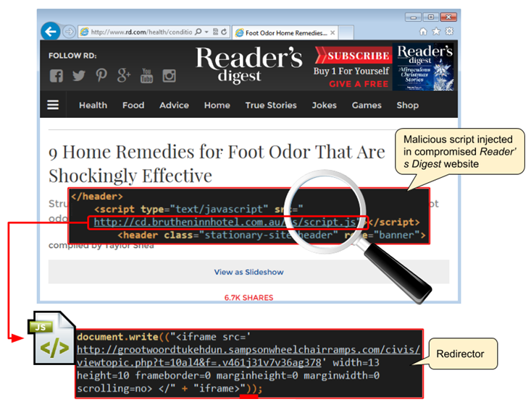
Notes:
The attack consists of a malicious script injected within compromised WordPress sites that launches another URL whose final purpose is to load the Angler exploit kit. Site owners that have been affected should keep in mind that those injected scripts/URLs will vary over time, although they are all using the same pattern (see IOCs below for some examples).
The website of popular magazine Reader’s Digest is one of the victims of this campaign and people who have visited the portal recently should make sure they have not been infected. The payload we observed at the time of capture was Bedep which loaded Necurs a backdoor Trojan, but that of course can change from day to day.

Slide 29
Quiz
Question: Confidentiality: Suppose you are making an online purchase and want to pay for it with your credit card. What is the best way to preserve confidentiality of your credit card information?
Check if the online connection is secured with SSL or TLS, you can then enter the credit card information.
Notes:
SSL (Secure Sockets Layers) and TLS (Transport Layer Security)

Slide 30
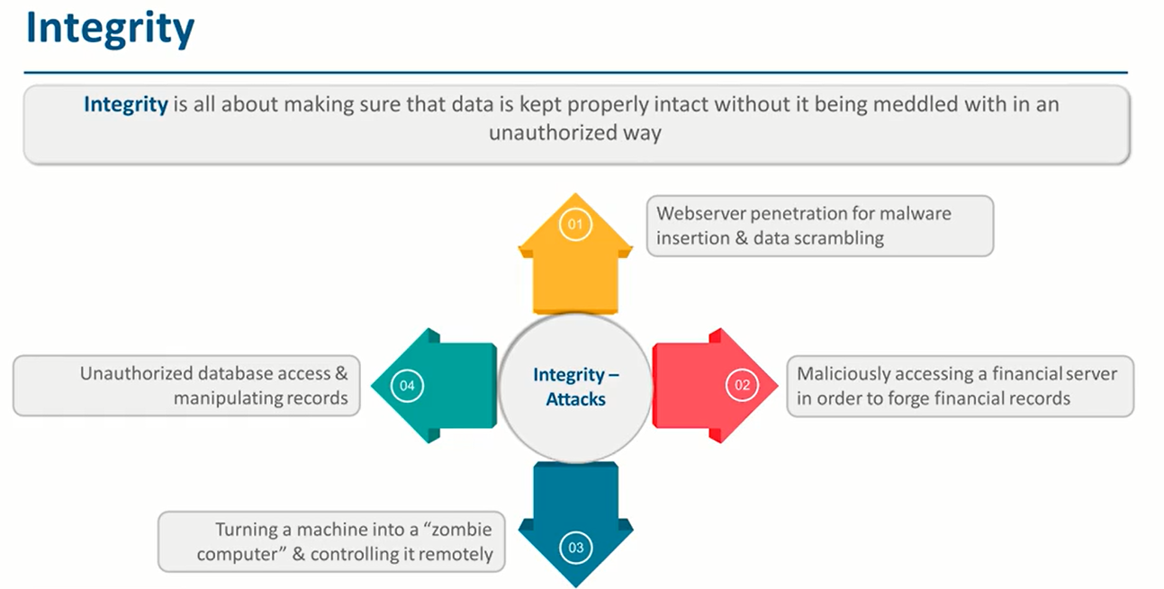
Notes:
Meddled (Intruded)

Slide 31
Integrity
Events that lead to integrity breaches include (non-intentional)
Accidentally deleting files
Entering invalid data
Altering configurations
Countermeasures
Hashing (data integrity)
Configuration management (system integrity)
Access control (physical and technical)
Software digital signing
Transmission cyclic redundancy check (CRC) functions

Slide 32
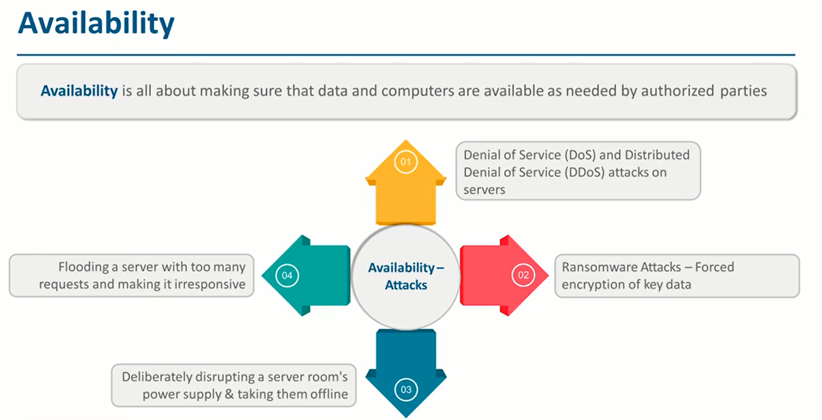

Slide 33
Availability
Countermeasures
Redundant array of independent disks (RAID)
Load balancing
Redundant data and power lines
Software and data backups
Co-location and offsite facilities
Rollback functions
Failover configurations

Slide 34
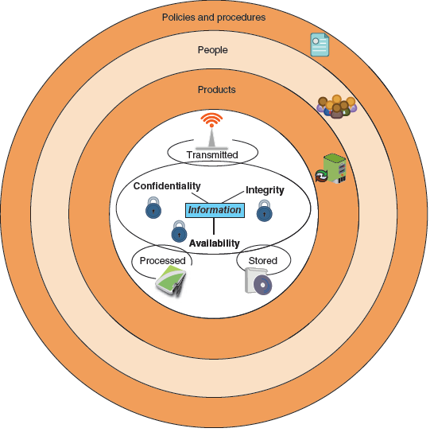
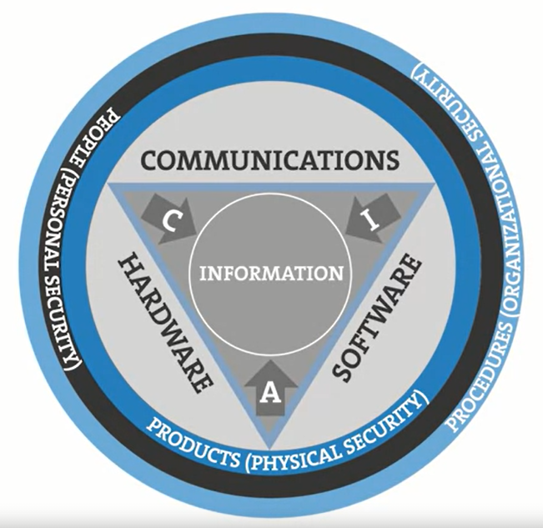
Information Security in an Organization
Notes:
Because information is stored on computer hardware, manipulated by software, and transmitted by communications, each of these areas must be protected.
Thus, information security may be defined as that which protects the integrity, confidentiality, and availability of information through products, people, and procedures on the devices that store, manipulate, and transmit the information.

Slide 35
4. SECURITY SERVICES ITU-T (X.800)
Notes:
International Telecommunication Union – Telecommunication
It provides a general description of security services and related mechanisms, which may be provided by the Reference Model.

Slide 36
SECURITY SERVICES ITU-T (X.800)
Confidentiality
Authentication
Integrity
Non-repudiation
Availability
Access Control

Slide 37



CONFIDENTIALITY (SECRECY)
Protect transmitted data
Protect against traffic analysis
INTERCEPTION Unauthorised party gains access to data
Timeliness

Slide 38


AUTHENTICATION
Assurance that message is from proper source
Protect from third party masquerade
FABRICATION
Insertion of “counterfeit” messages
Mutual Authentication
Notes:
Counterfeit (Fake)

Slide 39

INTEGRITY
Message is received as sent
Modification
Also interested in replay, re- ordering, deletion, delay
MODIFICATION
Gain access and “tampers”
with messages

Slide 40


AVAILABILITY
Availability of information/resources
Complete loss of availability
Reduction/Degradation in availability
INTERRUPTION
Loss of communication (cut
the cable)
DENIAL OF SERVICE
Noisy comms (physical noise,
spurious messages)

Slide 41
NON-REPUDIATION
Prevents parties from denying they sent or received a message; i.e. concerned with protecting against legitimate protocol participants, not with protection from external source
Receiver can verify and prove who sent a message
Sender can verify and prove who received a message
REPUDIATION ATTEMPT
Party anonymously publishes his or her message/key(s) and falsely claims that they were stolen.
Notes:
REPUDIATION (Denial)

Slide 42
ACCESS CONTROL
REPLAY
Record a legitimate message e.g. a login, and replay later
Limit & control access to host system/services
Limit & control access to networks
Authenticate each party so that access rights can be assigned
More fine-grained solutions, e.g. Digital Rights Management
Auditing Service
Notes:
Fine-Grained (detailed, in-depth, or involving fine detail )
fine-grained access control will work on smaller items. Fine-grained access control is the ability to grant or deny access to critical assets, such as resources and data, based on multiple conditions and/or multiple entitlements to a single data resource.

Slide 43
5. REFERENCE MODEL FOR INFORMATION ASSURANCE AND SECURITY

Slide 44
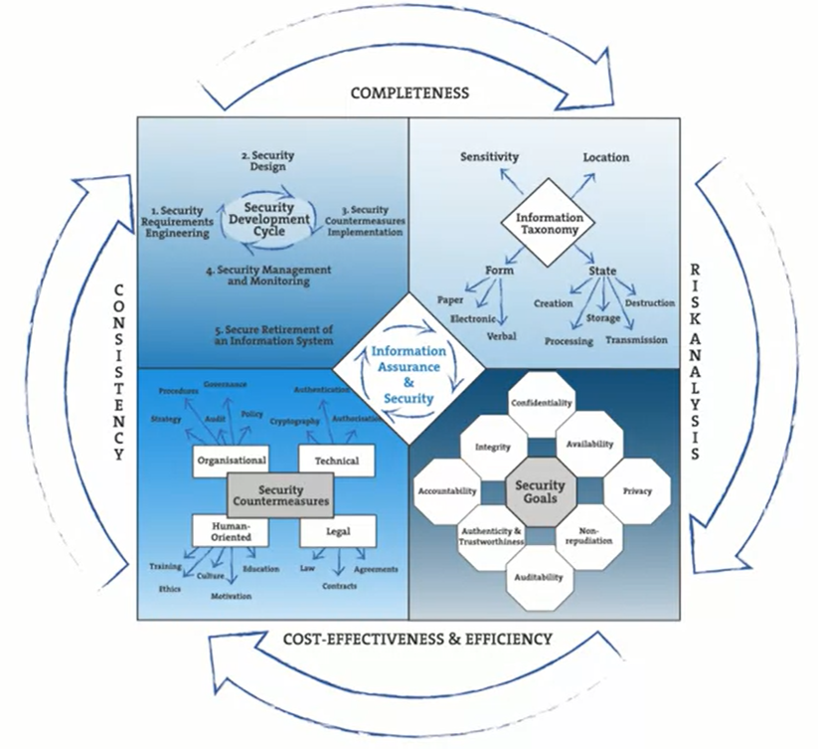
REFERENCE MODEL FOR INFORMATION ASSURANCE AND SECURITY

Slide 45
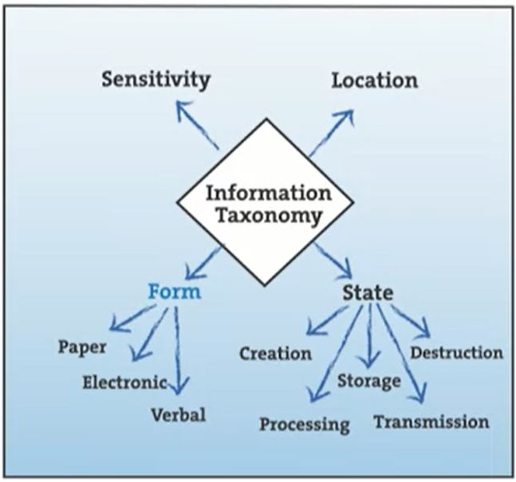

Slide 46
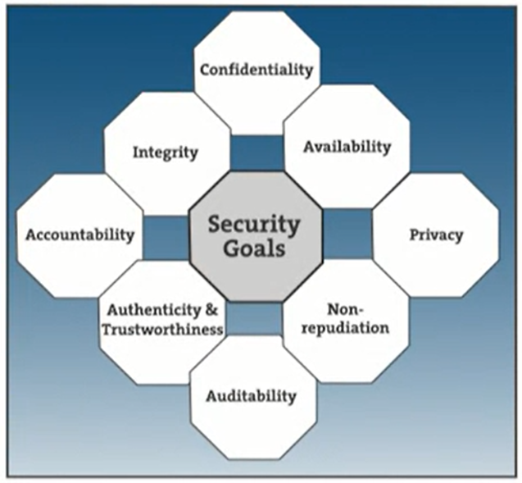

Slide 47
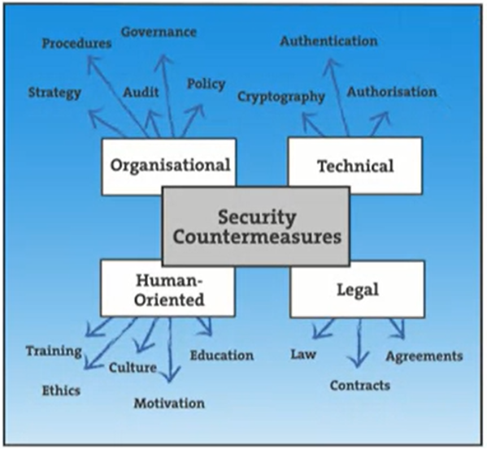

Slide 48
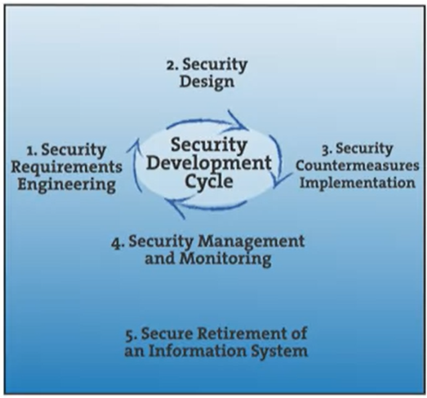

Slide 49
6. Active Vs. Passive Attacks

Slide 50
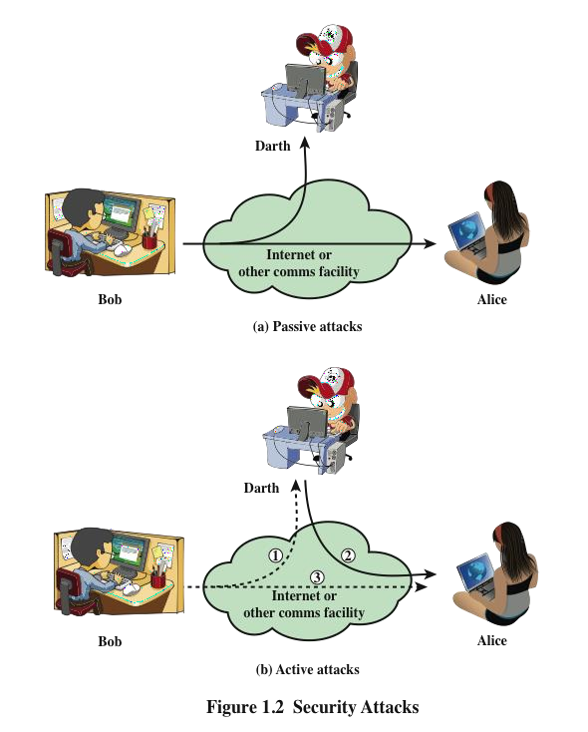
SECURITY ATTACKS
A means of classifying security attacks, used both in X.800 and RFC 4949, is in terms of passive attacks and active attacks
A passive attack attempts to learn or make use of information from the system but does not affect system resources
An active attack attempts to alter system resources or affect their operation

Slide 51
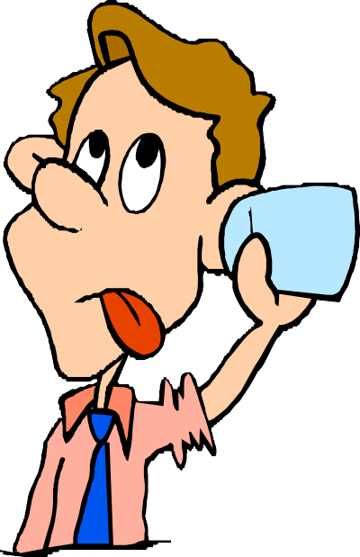
PASSIVE ATTACKS
Are in the nature of eavesdropping on, or monitoring of, transmissions
Goal of the opponent is to obtain information that is being transmitted
Two types of passive attacks are:
The release of message contents
Traffic analysis

Slide 52
ACTIVE ATTACKS
Involve some modification of the data stream or the creation of a false stream
Difficult to prevent because of the wide variety of potential physical, software, and network vulnerabilities
Goal is to detect attacks and to recover from any disruption or delays caused by them
Masquerade
Takes place when one entity pretends to be a different entity
Usually includes one of the other forms of active attack
Replay
Involves the passive capture of a data unit and its subsequent retransmission to produce an unauthorized effect
Modification of messages
Some portion of a legitimate message is altered, or messages are delayed or reordered to produce an unauthorized effect
Denial of service
Prevents or inhibits the normal use or management of communications facilities

Slide 53
7. Information Security Terminologies

Slide 54
Information Security Terminologies
Asset
Item of value
Data contained in an information system; or a service provided by a system; or a system capability; or an item of system equipment (i.e., a system component—hardware, firmware, software, or documentation).

Slide 55
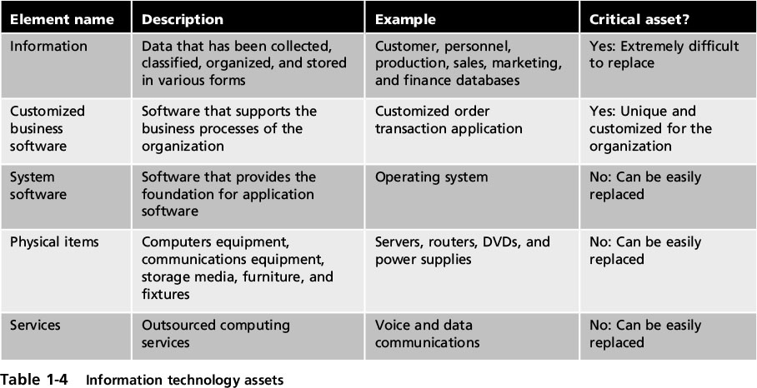
Information Security Terminology
Notes:
Information Security Terminology
Table 1-4 Information technology assets

Slide 56
SECURITY TERMINOLOGIES
Vulnerability:
A flaw or weakness in a system’s design, implementation, or operation and management that could be exploited to violate the system’s security policy.
Threat:
A potential for violation of security, which exists when there is a circumstance, capability, action, or event, that could breach security and cause harm. That is, a threat is a possible danger that might exploit a vulnerability.
Threat agent
Person or element with power to carry out a threat
Attack:
An attack is a threat that is carried out (threat action)

Slide 57
SECURITY TERMINOLOGIES
Risk:
An expectation of loss expressed as the probability that a particular threat will exploit a particular vulnerability with a particular harmful result
Countermeasure:
An action, device, procedure, or technique that reduces a threat, a vulnerability, or an attack by eliminating or preventing it, by minimizing the harm it can cause, or by discovering and reporting it so that corrective action can be taken.
Security Policy:
A set of rules and practices that specify or regulate how a system or organization provides security services to protect sensitive and critical system resources

Slide 58
GENERAL ATTACKS AND THREATS
Attacks can threaten security goals
Eavesdropping learning confidential information
Modification modifying a message in transit
Denial of service make the service unavailable (e.g., by keeping it busy)
Forging building a fake message, pretending it was sent by someone else
Masquerade posing as someone else in a single message transmission or interactive protocol
Repudiation denying having sent or received some message
Profiling gathering information about a single user
Fingerprinting identifying the user associated with some message
Traffic analysis learning origin, destination, length, times, of communications (not the content)

Slide 59
ASSETS
Data including archives
Computers, Disks, Tapes
CPU time, Storage, Net capacity
Comms (routers, switches, firewalls, modems, patch panels, bandwidth), Phones, Faxes
Air-conditioning systems/alarm systems, Physical Security
Manuals, guides
Printouts: reports, letters, emails, contracts
Configuration information
Passwords
Staff
Safety and health of personnel
Privacy of users
Public image and reputation
Customer/client goodwill
Share price
Intellectual property
Domain name

Slide 60
THREATS
Hardware errors
Terrorists
Theft, Malicious, Microsoft
Industrial espionage, Government
Malicious software
Pirating
Password cracking
Denial of Service
Masquerade
Misuse of resources
Social engineering
Reverse engineering
Acts of God, Fire, Earthquakes,
Disaffected employees
Human error
Illness & Injury
Economic downturns

Slide 61
THREATS
Unreliable software, bugs
Viruses, worms, trojan horses, bombs, trap doors, spoofs, artificial life-forms, password crackers, Cryptanalysis, Microsoft
Disgruntled, blackmailed, bribed, greedy employees or ex-employees
Hackers
Government agencies, military spies, industrial spies, criminals, terrorists
ISPs, Backbone Providers
BIGGEST THREAT?

Slide 62
COUNTERMEASURES
Protect buildings, equipment and people from unauthorised access, natural disasters
Use fibre optic cabling, Shield equipment & cabling
Use reliable H/W & S/W, Shredder
Keep backups & standby systems
Use “good” cryptography
Use firewalls, simulated attacks
Use good password admin, virus checkers, intrusion detection s/w, auditing software, biometrics
Isolate network
Counter-intelligence, Ethical hackers, Security guards, Lawyers
Employ trustworthy staff, background checks
Train/educate staff
Keep staff happy
Insure
Good legal backup
Take security seriously (planning, administration, risk assessment, cost/benefit analysis, paranoia level)
Splendid Isolation

Slide 63
POLICIES
Set of well-defined, consistent and implementable rules (security requirement). Policies should be general and change little over time.
Consider an online auction company such as E-bay which allows most users to buy and sell goods online. Sellers can post details of their goods on E- Bay’s web site and interested buyers can bid for the goods.
What policies might the users of the system want applied?

Slide 64
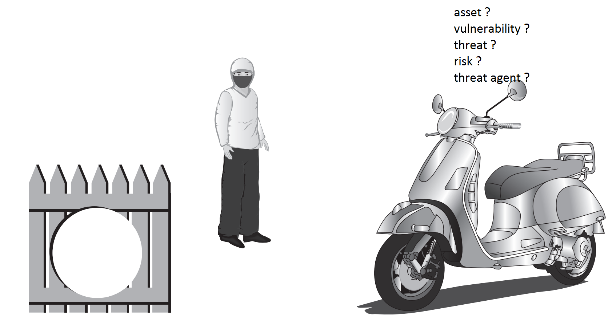

Slide 65
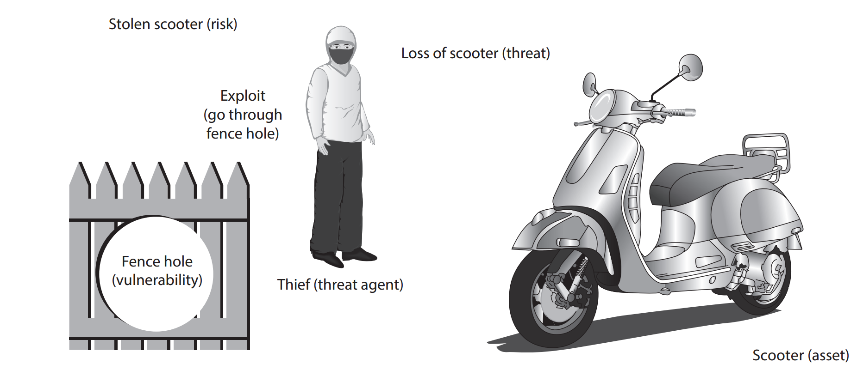

Slide 66
Risk Management
Options to deal with risk:
Risk avoidance - involves identifying the risk but not engaging in the activity (i.e. not to buy the scooter)
Acceptance - risk is acknowledged but no steps are taken to address it (i.e. ignore the risk and buy the scooter any way)
Risk mitigation - the attempt to address the risks by making risk less serious (i.e. request the management to fix the fence by making the risk less serious)
Deterrence - understanding the attacker and then informing him of the consequences of his actions (i.e. put a sign board to warn the attacker of the consequences of stealing)
Transference - transferring the risk to a third party (i.e. insurance)

Slide 67
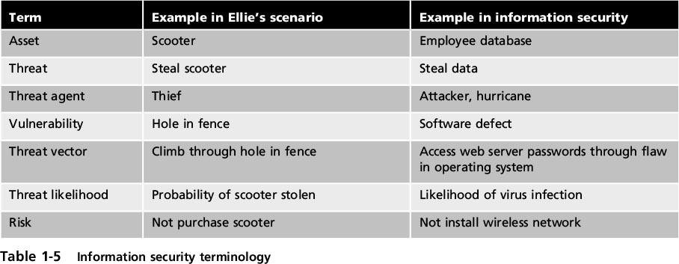
Information Security Terminology
Notes:
Information Security Terminology
Table 1-5 Information security terminology

Slide 68
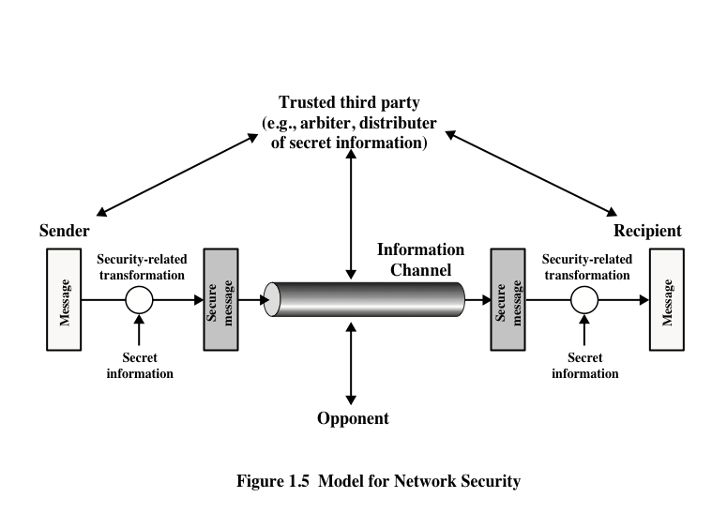
MODEL FOR NETWORK SECURITY

Slide 69
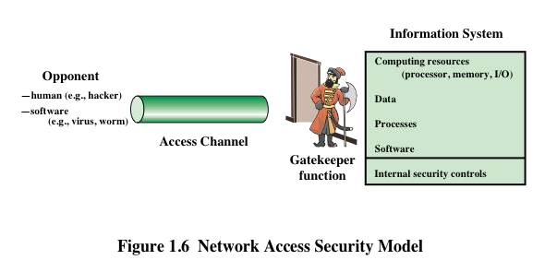
NETWORK ACCESS SECURITY MODEL

Slide 70
INFORMATION SECURITY IS CHALLENGING
Security is not simple
Potential attacks on the security features need to be considered
Procedures used to provide particular services are often counter-intuitive
It is necessary to decide where to use the various security mechanisms
Requires constant monitoring
Is too often an afterthought
Security mechanisms typically involve more than a particular algorithm or protocol
Security is essentially a battle of wits between a perpetrator and the designer
Little benefit from security investment is perceived until a security failure occurs
Strong security is often viewed as an impediment to efficient and user-friendly operation

Slide 71
References
CompTIA Security+ Guide to Network Security Fundamentals, Fifth Edition by Mark Ciampa
Corporate Computer Security, by Randall J. Boyle, 3th Edition
Cherdantseva Y. and Hilton J. "A Reference Model of Information Assurance & Security," Accepted to SecOnt 2013 workshop which will be held in conjunction with the 8th International Conference on Availability, Reliability and Security (ARES) 2013, University of Regensburg, Germany. September 2nd - 6th, 2013.

Slide 72
Data Breaches
Study the world’s biggest data breaches in various industry sectors
Filter the data based on methods of leak and number of records stolen
Use the link:
https://informationisbeautiful.net/visualizations/worldsbiggest-data-breaches-static/

Slide 73
Internet Threat Scenario
Monitor the global cyber threat scenario including hacking, bots, and malware attacks using live threat maps
Identify hacking attempts or cyber-attacks from different parts of the world as they happen in real time
Use the link:
https://www.fireeye.com/cyber-map/threat-map.html

Slide 74


